Slide 1
Portfolio Orientation

Slide 2
Portfolio Generation
You will create your own portfolio through RevaturePro
Includes information about yourself, your background, your skills, and your project experience
Helps to market yourself to potential clients
Important: make a good first impression
Use the guidelines to help you write and complete the portfolio

Slide 3
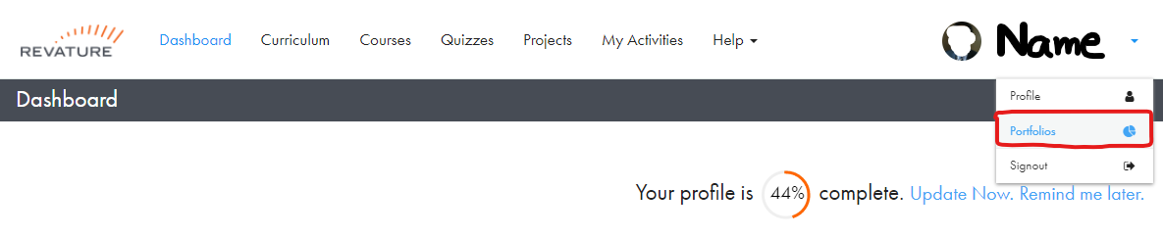
Setup Your Portfolio
Login to RevaturePro
Go to “Portfolios”
Click on “Create Portfolios”
Note: you may need to update your “Profile Name” before you can create your portfolio

Slide 4
Setup Your Portfolio
Enter a name for your portfolio
This does NOT appear on the published version of the portfolio
Use the convention {{First Name-Last Name-version}}
E.g. “Andrew-Crenwelge-1”
Fill out the portfolio according to the guidelines

Slide 5
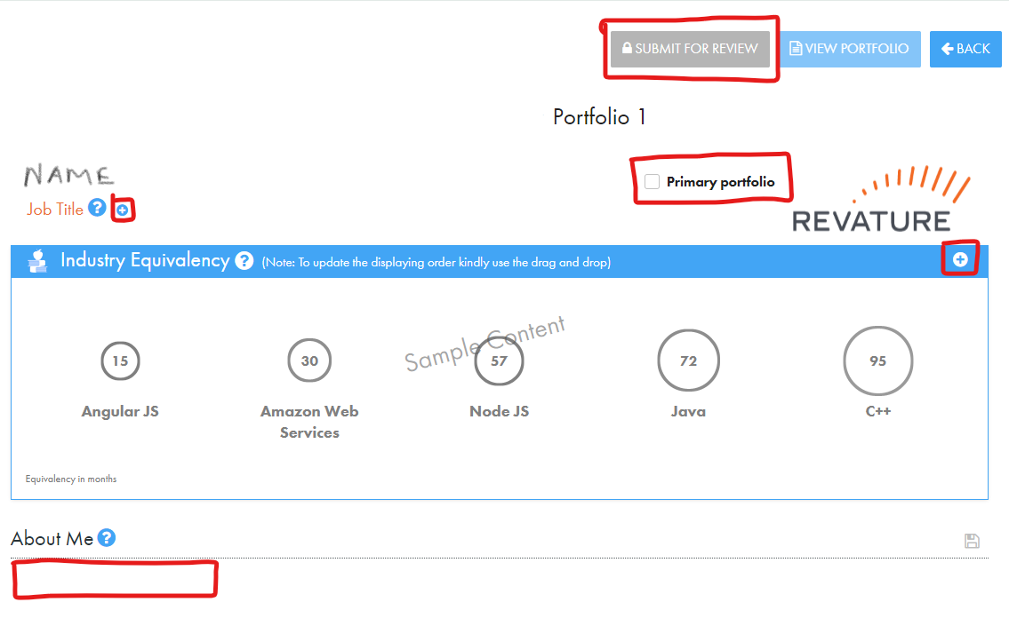
Adding Title & About Me

Slide 6
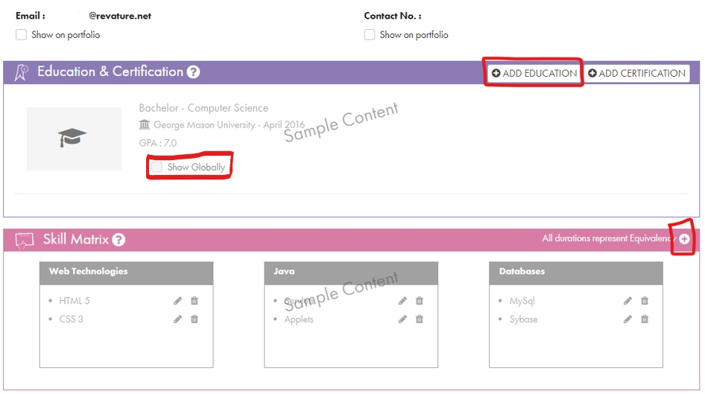
Adding Education & Skills Matrix

Slide 7
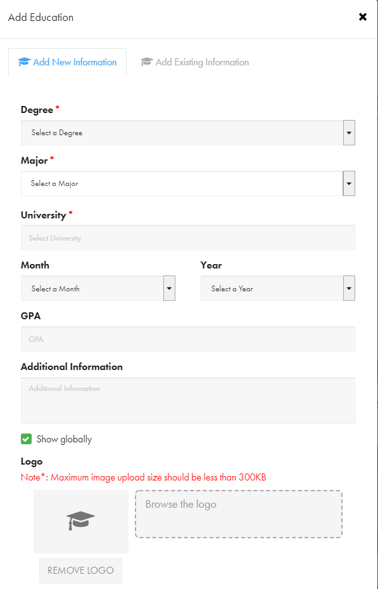
Education Details

Slide 8
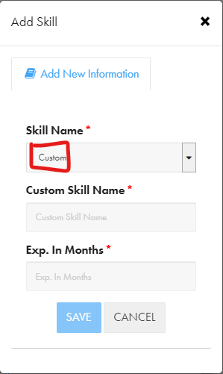
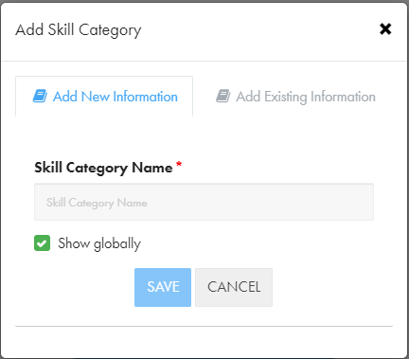
Skills Matrix

Slide 9
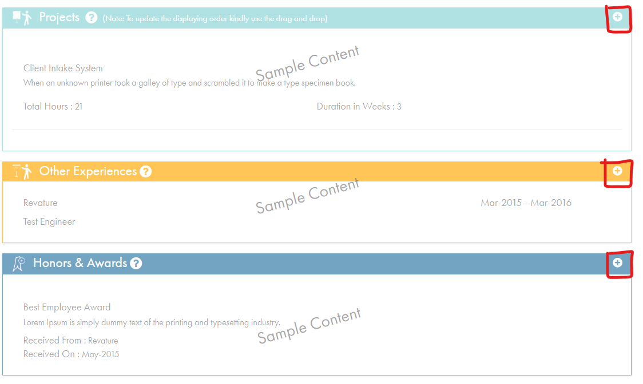
Adding Projects, Other Experiences, and Honors

Slide 10
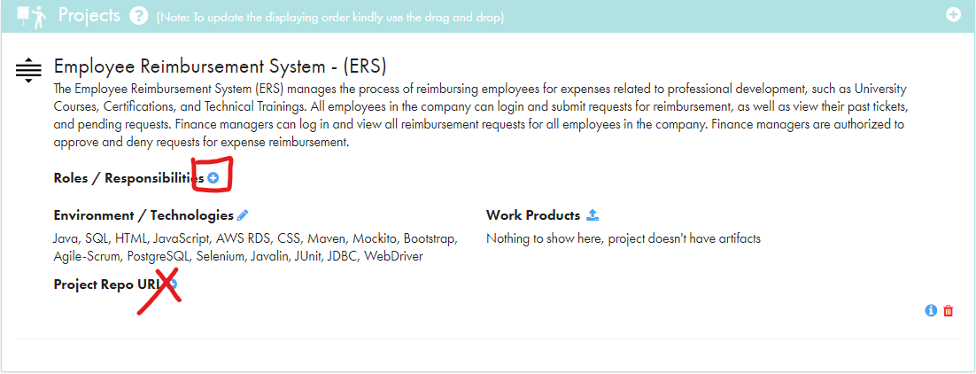
Project Bullet Points

Slide 11
Review Process
YES
Phase 1 Work
Name & Title
About Me
Education
Project 1
Create Portfolio
Corrections?
Submit for Review
NO
QC auditor submits to QC Manager
NO
Corrections?
Phase 2 Work
Skills Matrix
Industry Equivalency
Project 2
Submit for Review
Published by QC Manager
YES
Portfolio Appears as “Approved”
Link sent to Sales and Delivery teams for sharing with client

Slide 12
Remember…
Dharshanaa from our team in India does the initial Phase 1 review
Your QC auditor does final Phase 2 reviews
Before you submit your portfolio, proofread it for formatting, grammar, and spelling mistakes
You cannot edit your portfolio after you submit it; you must wait for feedback
Check your revature.net email for updates, reminders, and feedback
Do NOT clone your portfolio unless asked to do so
Do NOT mark your portfolio as “inactive” after it has been published
If you have questions, ask your QC auditor before or after the QC session

Slide 13
Sample
Let’s review this example of a good portfolio

Slide 14
Deadlines (all are COB)
Phase 1 submission: 8/3
Phase 1 review: 8/5
Phase 2 submission: 8/15
Phase 2 review: 8/17
Final due date for publication: 8/19
Training end date: 9/2

Slide 15
Questions?

